Slide 1
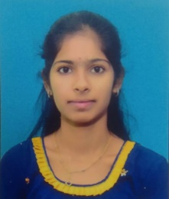
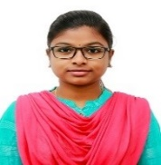
Rupa V
Designation : Associate Software Engineer Staff/Assistant
Mobile: | +91 6300984721
Email: | Rupa.v@gds.ey.com
Background
Rupa is an Associate Software Engineer in GDS Technology Consulting services in EY LLP
Joined Ernst & Young in March 2022 and is based in Hyderabad
She had completed Bachelor of Engineering in Computer Science and Engineering
Professional Experience
Joined as a fresher In March 2022
Currently in Application and Managed services Team
Responsibilities
She keeps track of all the issues occurred on daily basics
She had done Designing Cyber Insurance Policies : The role of Pre-screening and Security Interdependence Project in Final Year Engineering .The main purpose of this is to Protect your digital enterprise against the cyber-attacks and internal malicious behavior with end-to-end advisory protection and security monitoring services
Skills
She has good knowledge on SQL, Java and C Programming languages
She has been under training on Power Platform
She is good in English and Telugu languages

